Slide 1
Seoul National University Asia Center

Slide 2
Seoul National University Asia Center(SNUAC) is a research and international exchange institute specializing in Asian Studies that integrate regional and thematic topics. It has five regional centers, seven thematic programs, and the social science data archive (KOSSDA). SNUAC is also fully engaged in building
a global network of scholars in Asian studies, nurturing
next-generation experts as well as
promoting other scholarly
activities.
About SNUAC

Slide 3
Sep 2009
The First SNUAC International Conference
<What Is Asia?: Retrospectives and Prospects>
Sep 2013
Prof. Myungkoo Kang
The Second SNUAC Director
1
2
3
4
Feb 2009
Inauguration of SNUAC
(Director: Prof. Hyun-Chin Lim)
Oct 2011
The Second SNUAC International Conference
<Global Challenges in Asia: A New Development
Model and Regional Community Building>
Jun 2015
Joining of Korea Social Science
Data Archive (KOSSDA) into SNUAC
Jun 2018
Launch of the
Asia Region Review Webzine
DiverseAsia
5
6
7
8
9
Mar 2014
Asia Research Directors Conference
<New Horizons of Asian Studies>
Apr 2016
International Conference
<InterAsian Connections V: Seoul>
Sep 2019
The 10th Anniversary
of SNUAC
- Preparing the Second Launch of SNUAC
Very Brief History of SNUAC

Slide 4
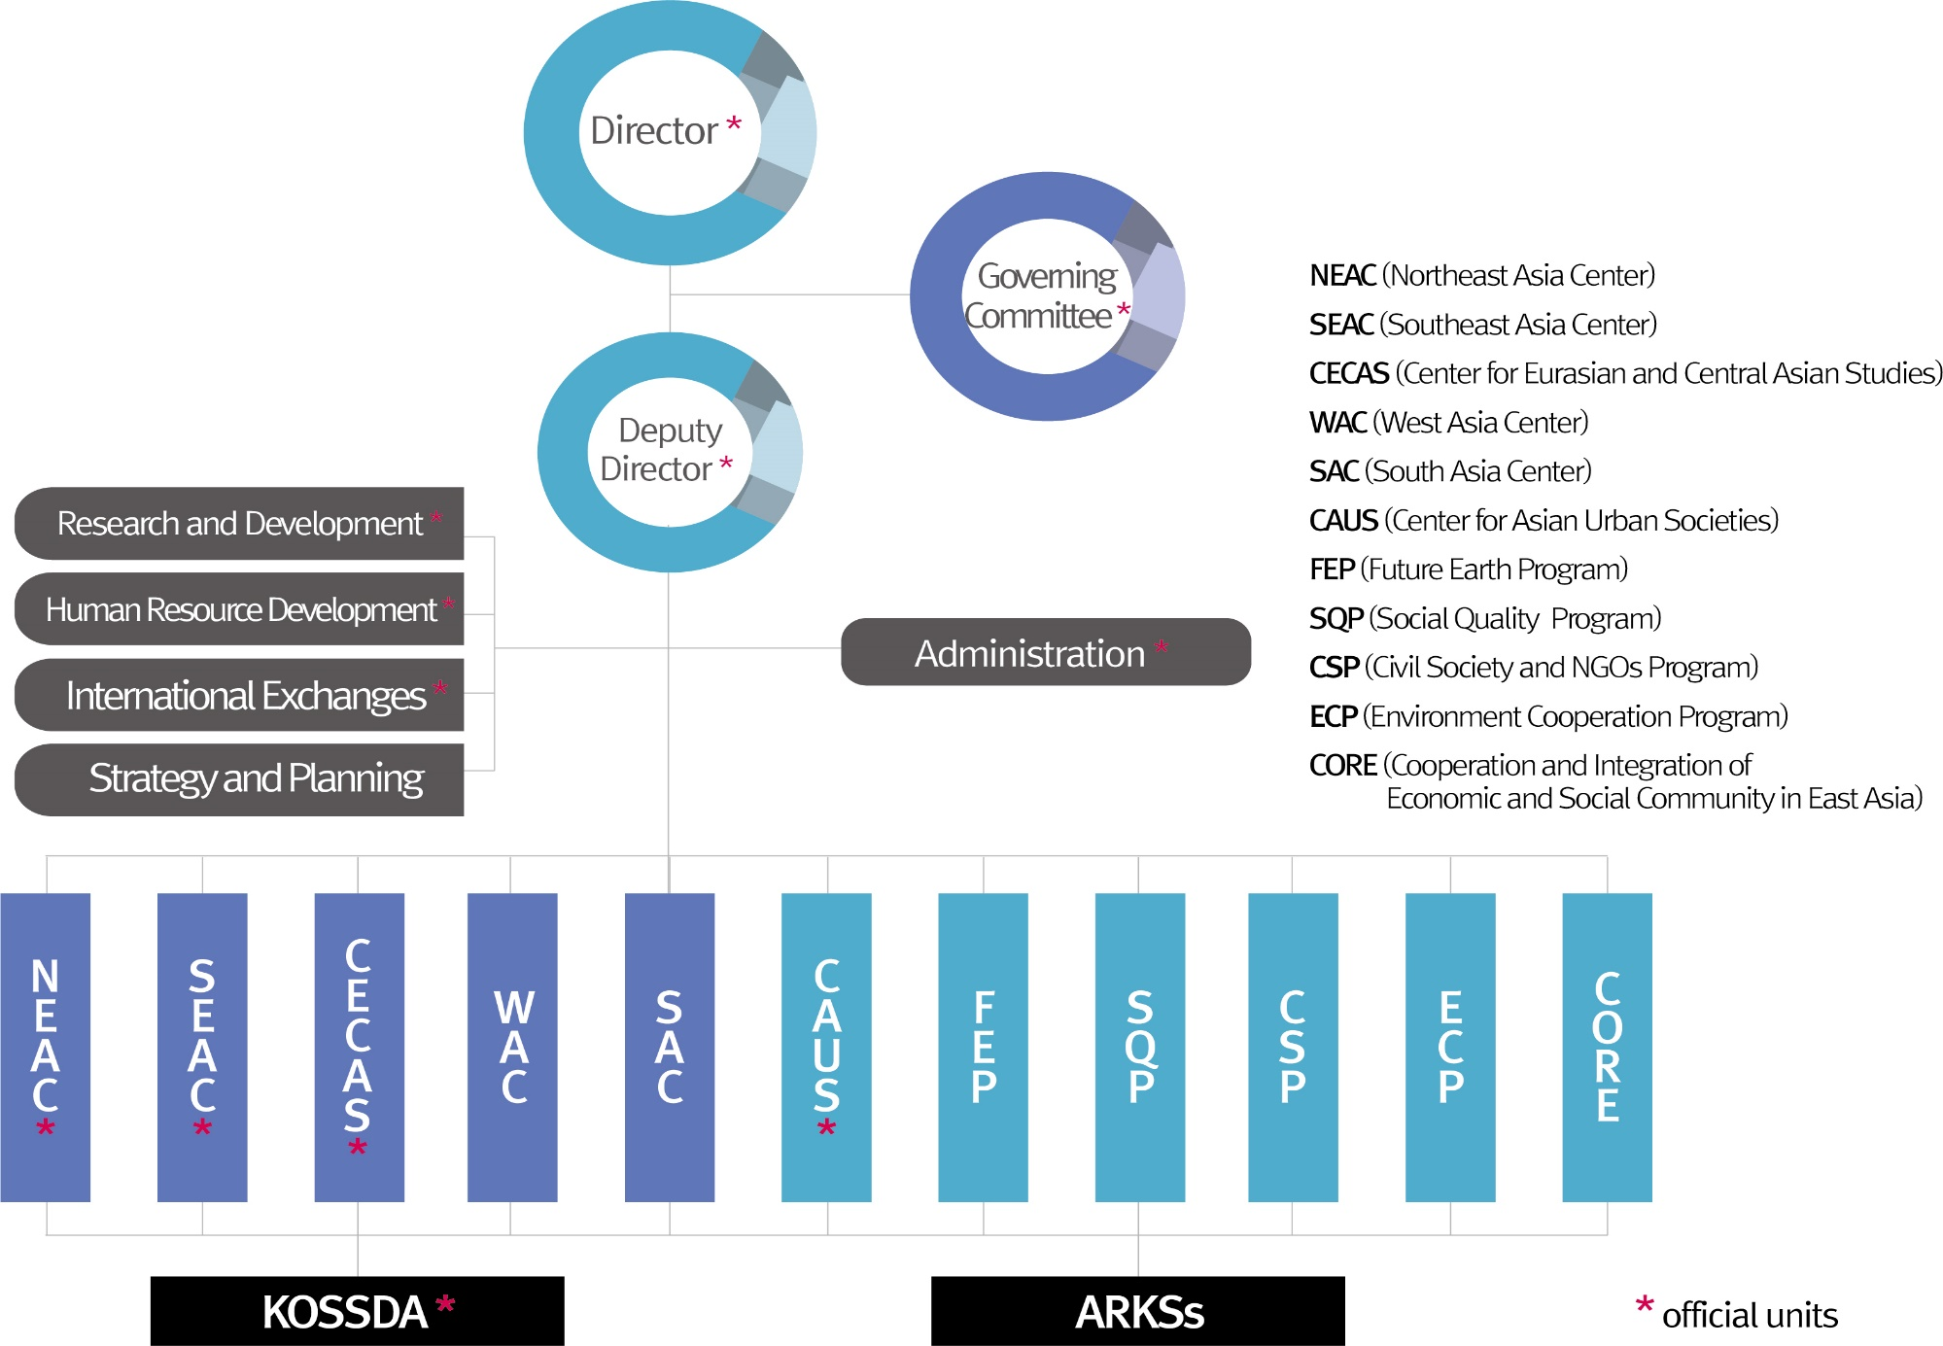
Data
Archiving
General
Public
Research
Institute
Government
Overseas
Universities
SNU
Regional Research Insts.
SNUAC
Research
Outcomes
Business
NGO/NPO
Organization Chart of SNUAC

Slide 5
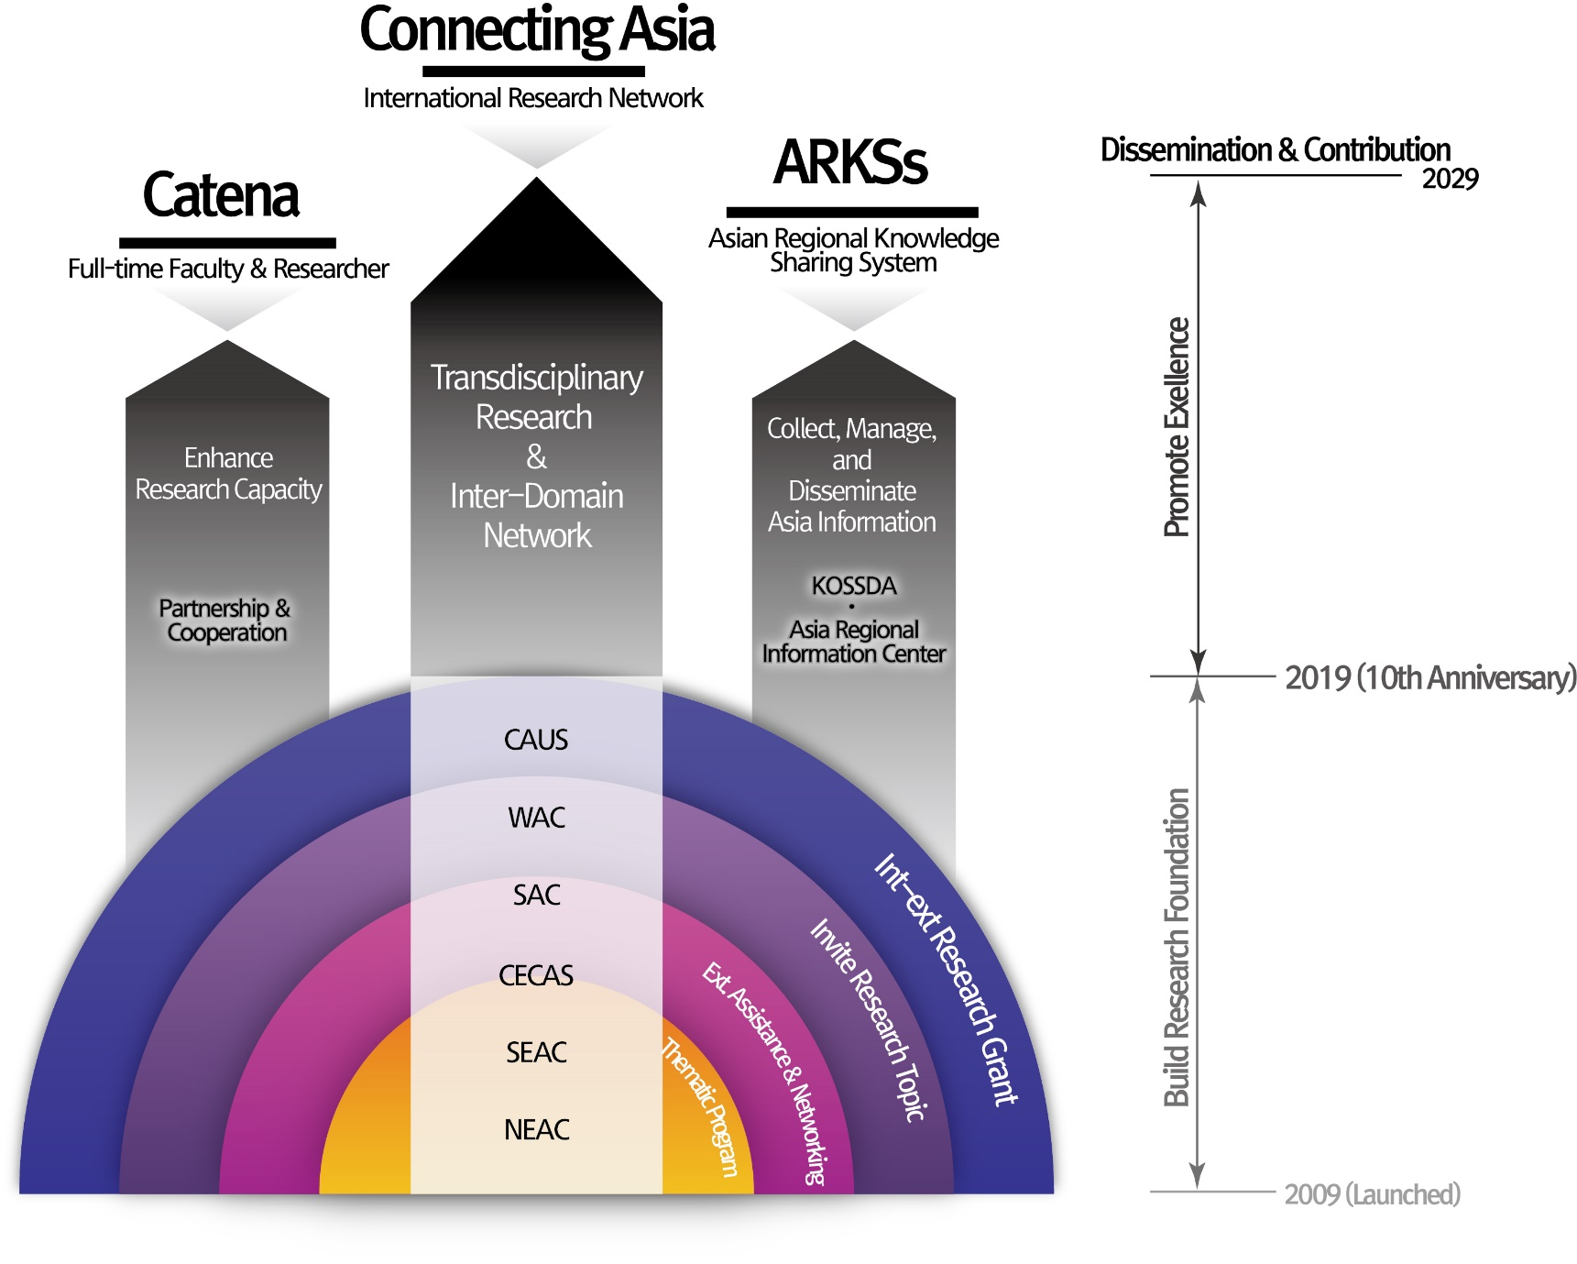
Vision
Open Asian Studies: Knowledge creation and sharing for the future
Integration of regional studies and thematic research
Global hub of Asian studies
SNUAC’s Goals and Strategies

Slide 6
24
26
12
30
28
25
6
14
14
Faculty
2013
2014
2015
Research Fellows
25
Visiting Research
Scholars
25
26
25
29
26
27
12
12
2016
2017
2018
Researchers

Slide 7
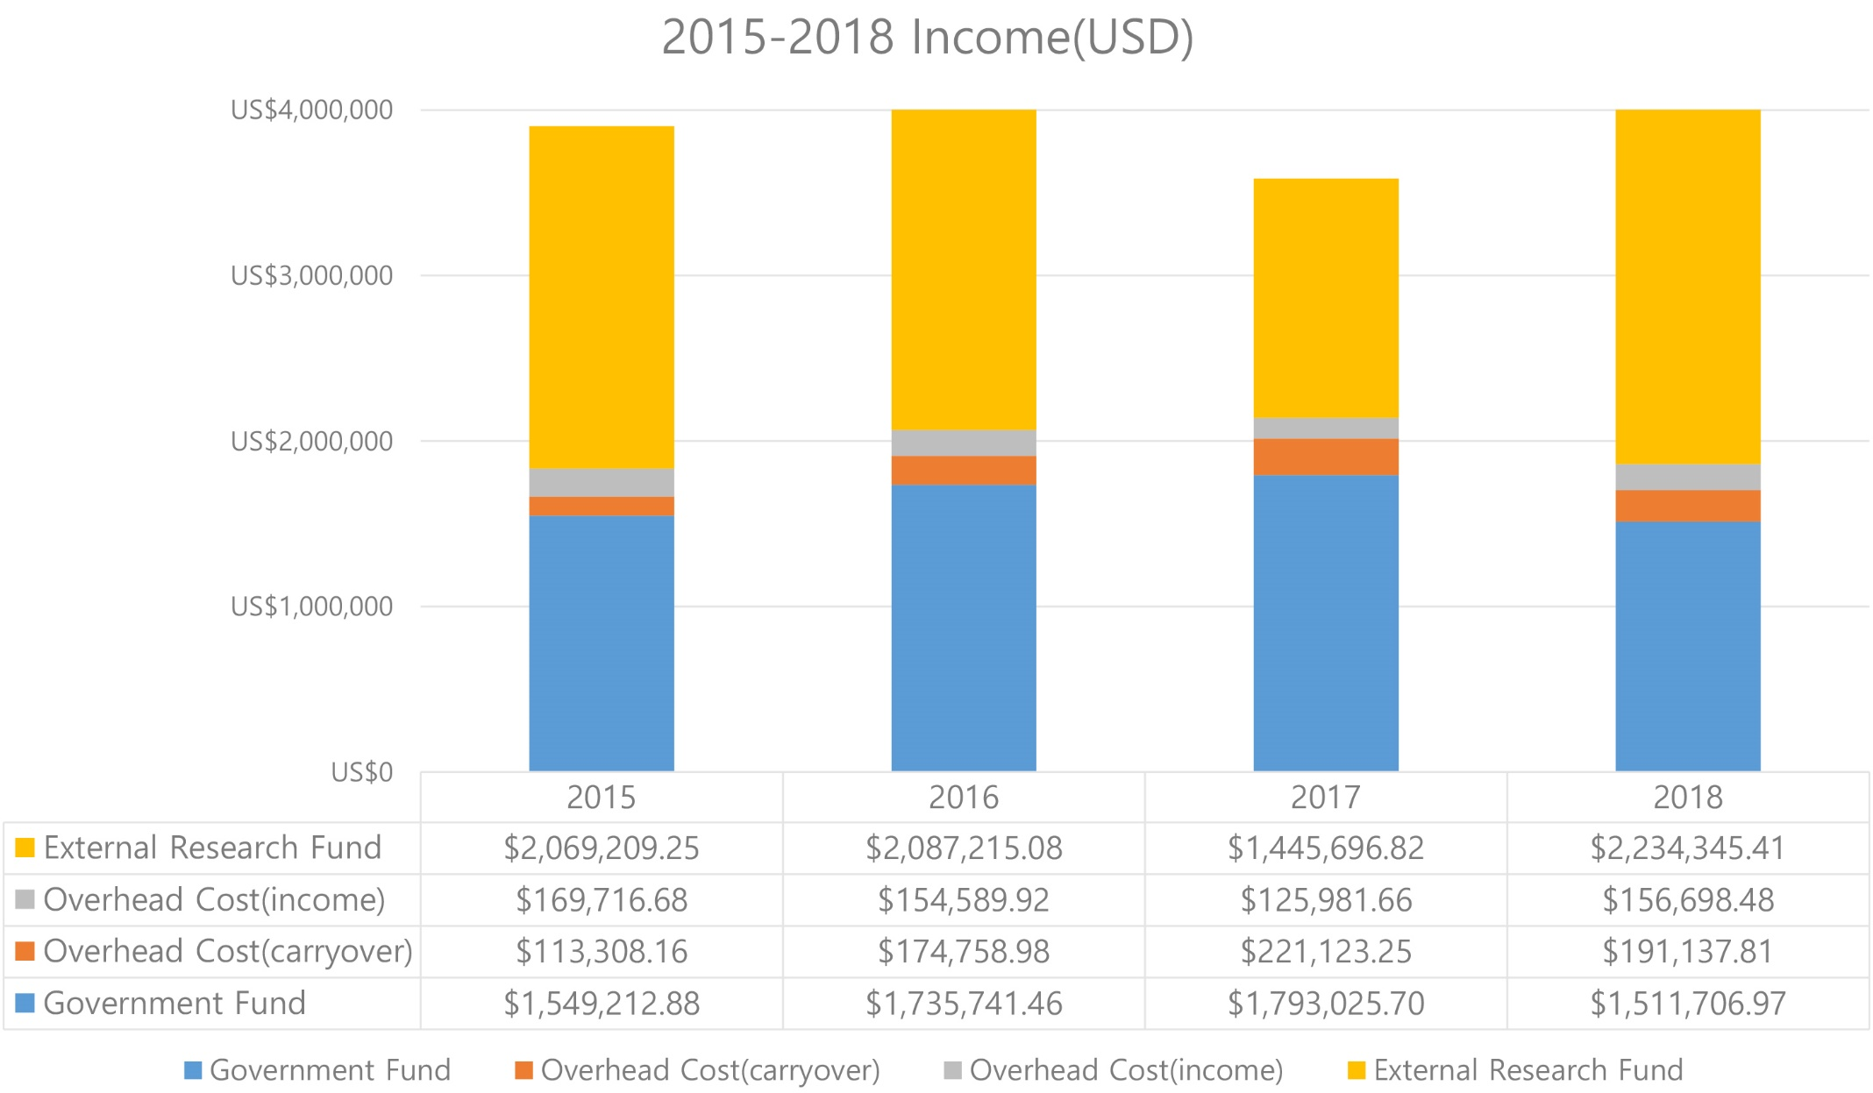
Budget

Slide 8
5 Regional Centers
+
KOSSDA
(Data Archive Center)
7 Thematic
Centers and
Programs
Research

Slide 9
Northeast Asia Center
KOSSDA
(Korea Social Science Data Archive)
Transformations in Northeast Asian societies
1
6
Korea’s representative data archive
Social data dissemination
Data analysis training
Southeast Asia Center
Consumer culture
Sustainable economic cooperation
5 Regional Centers
+
KOSSDA
2
5
West Asia Center
Gender and migration
Islamic culture and societies
Center for Eurasian
and Central Asian Studies
3
4
South Asia Center
Central Asian Islam
Eurasian diasporas
Economic Development
Textile Industries
Education in Universities
Research - 5 Regional Centers + KOSSDA(Data Archive Center)

Slide 10
Asian Regional Information Center
Regional Information/ Knowledge Sharing System/Diverse Asia
7 Thematic
Centers and
Programs
SSK Research Project on East Asian Urban Societies
Developmental urbanization / Just city / Sustainable city / Urban commons
Social Quality Program
Social Equality/ Social Securities / Human Development/Quantitative Analysis
Future Earth Korea Program
Sustainable Development of Asia / Sustainability of the Korean Penninsular
Civil Society NGOs Program
Korean civil society / Asian civil society / Global civil society
Exchange and Cooperation Program
International Trade and Migration / Cultural Evolution and Integration of Asia/ Silkroads
Social Big Data Program
Data Science/Robot Journalism/ Pattern Recognition
7 Thematic Centers and Programs

Slide 11
Exchange
Programs
Education
Programs
Activities

Slide 12
▪ Exchanges of leading scholars in Asian
Studies
▪ Research exchanges through
seminars and other
scholarly activities
▪ Network for cooperation with Asia
research institutions domestic and
abroad
▪ Agreement-based
exchanges with 24
institutions in 10 countries
Visiting Scholars
Program
Research & Exchange
Network
Exchange
Programs
International Collaborative
Projects
▪ International joint projects
▪ ICAS Book Prize for Asian Studies (Korean language edition)
▪ News from Northeast Asia, IIAS Newsletter
Exchange Programs

Slide 13
Education
Programs
KF Global e-School Program
Real-time online lectures to undergraduate and graduate students of leading
overseas universities interested in modern Korean society
KOSSDA Methodology Training Programs
Methodology education programs designed to enhance research skills
in collecting, searching, and analyzing data
Research Internship
Internship program that integrates research and education to foster future experts in Asia
Open Lecture on Southeast Asia
Annual lecture series by SNUAC Southeast Asia Center open to
researchers and the general public on important themes in Southeast Asia including culture and politics.
Education Programs

Slide 14
Seoul National University Asia Center
(June, 2019)

