Slide 1
Seoul National University
Asia Center

Slide 2
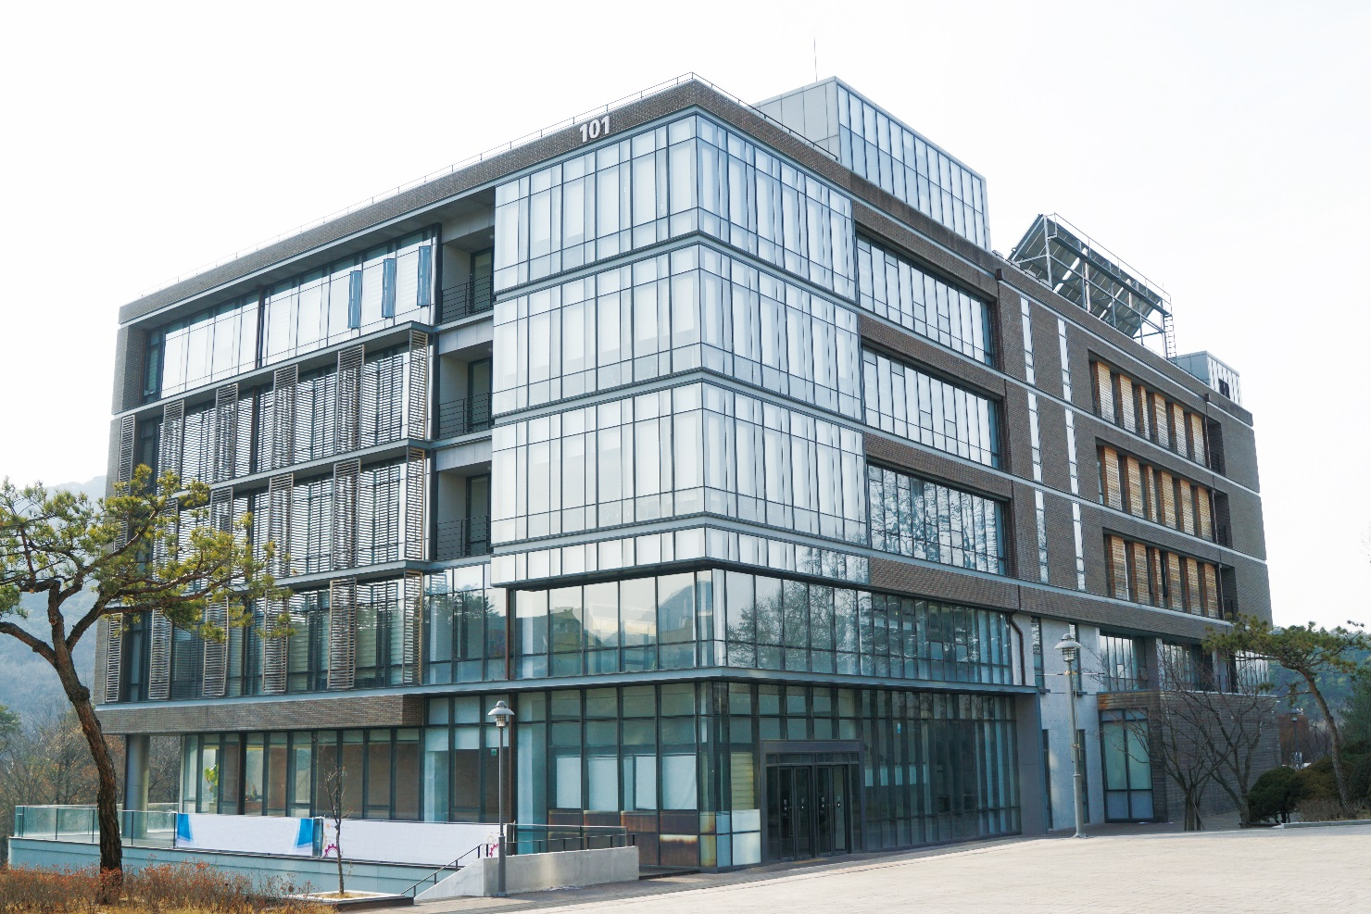
Seoul National University Asia Center(SNUAC) is a research and international exchange institute specializing in Asian Studies that integrates regional and thematic topics. It has three regional centers, seven thematic programs, and the social science data archive (KOSSDA). SNUAC is also fully engaged in building a global network
of Asia scholars, nurturing next-
generation experts as well as
promoting other scholarly
activities.
About SNUAC

Slide 3
Sep 2009
First SNUAC International Conference
<What Is Asia? Retrospectives and Prospects>
Sep 2013
Appointment of
Prof. Myung-koo Kang
as SNUAC Director
1
2
3
4
Feb 2009
SNUAC Inauguration
(Founding Director: Hyun-Chin Lim)
Oct 2011
Second SNUAC International Conference
<Global Challenges in Asia: A New Development Model and
Regional Community Building>
Jun 2015
Affiliation of Korea Social Science
Data Archive (KOSSDA) with SNUAC
Sep 2017
Appointment of
Prof. Soojin Park
As SNUAC Director
5
6
7
8
Mar 2014
Conference for directors of
Asia research institutions,
<New Horizons in Asian Studies>
Apr 2016
International conference
<Inter-Asian Connections V: Seoul>
Timeline

Slide 4
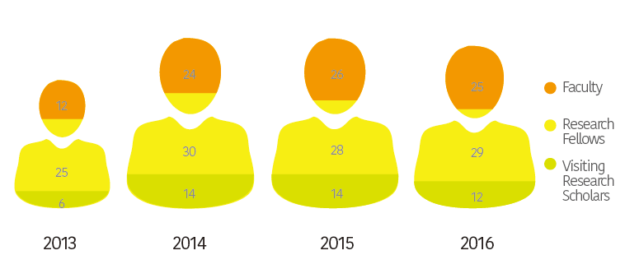
텍스트입력
텍스트입력
텍스트입력
Researchers

Slide 5
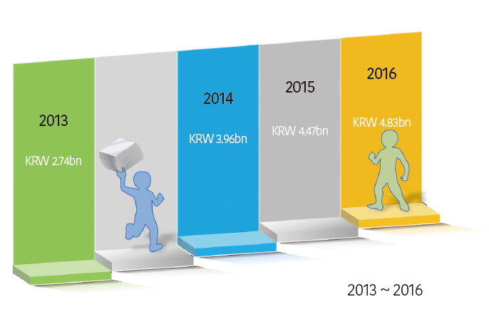
텍스트입력
텍스트입력
텍스트입력
Budget

Slide 6
3 regional centers
+
KOSSDA
(Data Archive Center)
7 thematic
programs
SNUAC’s research

Slide 7
Northeast Asia Center
Southeast Asia Center
Focuses on transformations in East Asian societies and their relations with each other due to rise of China
Culturally sensitive marketing
strategies and sustainable
economic cooperation:
Consumer culture of Indonesia
and Malaysia
1
2
3 regional centers
+
KOSSDA
3
4
Center for Eurasian
and Central Asian
Studies
KOSSDA
(Korea Social Science Data
Archive)
-Central Asia as a region
-Characteristics of Central Asian Islam
-Situation of Eurasian diasporas
Korea’s representative data
archive leading in the
acquisition and dissemination
of social science research data
Research - 3 regional centers + KOSSDA(Data Archive Center)

Slide 8
Key Research Institute Program
7 thematic
programs
East Asian economic community/East-Asian social and cultural community
Program on US-China Relations
텍스트입력
US-China relations/East Asian security/Korea’s security
Center for Democracy and Economic Development
Sustainable democratic and economic development of Asia/Civil politics/
Civil economy
Civil Society NGOs Program
Korean civil society/Asian civil society/Global civil society
텍스트입력
텍스트입력
Center for Asia and Global Economic Order
International trade/Technology, patenting/Regulations and standards
Environment Cooperation Program
Regional human environment/Tradition and future/Regional natural environment
Researchers – 7 thematic programs

Slide 9
Exchange
Programs
Education
Programs
Activities

Slide 10
Exchange programs
▪ A space for exchanges among
leading scholars in Asian Studies
▪ Research exchanges through regular
seminars by visiting scholars every
semester
Visiting Scholar
Program
Research &
Exchange
Network
▪ Network for cooperation with Asia
research institutions domestic and abroad
▪ Agreement-based exchanges with
22 institutions in 9 countries
International
Collaborative
Projects
▪ International collaborative
research projects
▪ Supervision of ICAS Book Prize for
Outstanding Academic Books on Asia
(Korean language edition)
▪ Regular contributions to the News
from Northeast Asia section of IIAS
Newsletter

Slide 11
KF Global e-School Program
Real-time online lectures for undergraduate and graduate students of leading
overseas universities interested in modern Korean society
Education
programs
KOSSDA Methodology Training Programs
텍스트입력
Methodology education programs designed to enhance researchers’ skills
in collecting, searching, and analyzing data
Research Internship
Integrates research and education to foster future specialists in Asian Studies
Advanced Courses by Southeast Asia Experts
텍스트입력
텍스트입력
Briefing sessions conducted jointly with KOTRA Academy and designed to
facilitate advancement to Indonesia
Asia-Pacific College
A joint Korea-Japan experiential program designed to help students develop
an international outlook on Korean-Japanese relations; conducted
alternately in Seoul and Fukuoka
Researchers – 7 thematic programs

Slide 12
Thank You

